Slide 1

DOMAIN MACHINE LEARNING
Machine learning is the science of getting computers to act without being explicitly programmed.
It is the scientific study of algorithms and statistical models ,relying on patterns and inference instead.

Slide 2
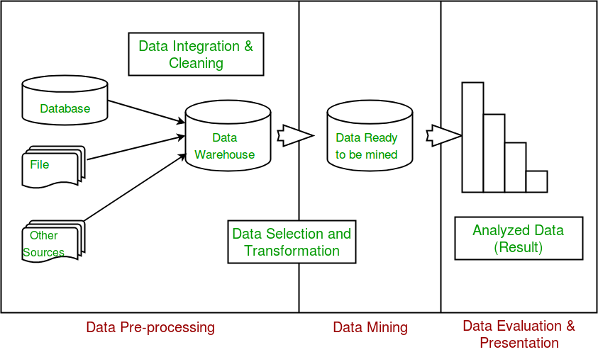
DOMAIN DATAMINING
Principle of storing through large amounts of data and picking out relevant information.
Useful information Process of analyzing data from different perspectives.
Summarizing it into useful information.

Slide 3
ABSTRACT
Credit card fraud is a serious problem in financial services.
There are lack of research studies in analyzing real world credit card data owning to confidentiality issues.

Slide 4
INTRODUCTION
In avoiding fraud 2 mechanisms:
-fraud detection
-fraud prevention
It is either physically or digitally.

Slide 5
Cont.....
The global credit card fraud in 2015 is USD $21.84 billion.
We use real-world time credit card dataset and dynamic data.

Slide 6
EXISTING SYSTEM
In Existing System they have used three methods for fraud detection.
1.Clustering model
2.Gaussian mixture model
3.Bayesian networks

Slide 7
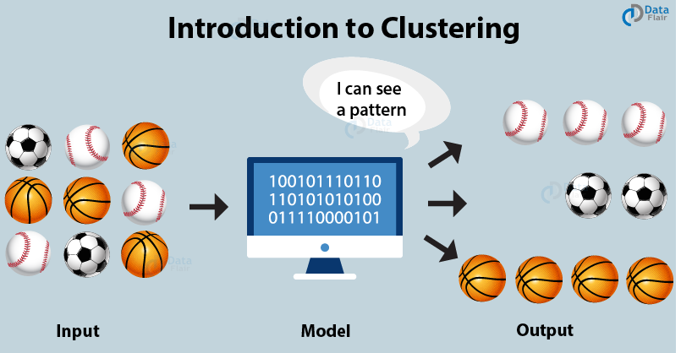
CLUSTERING MODEL
Clustering is the process of making a group of abstract objects into classes of similar objects.

Slide 8
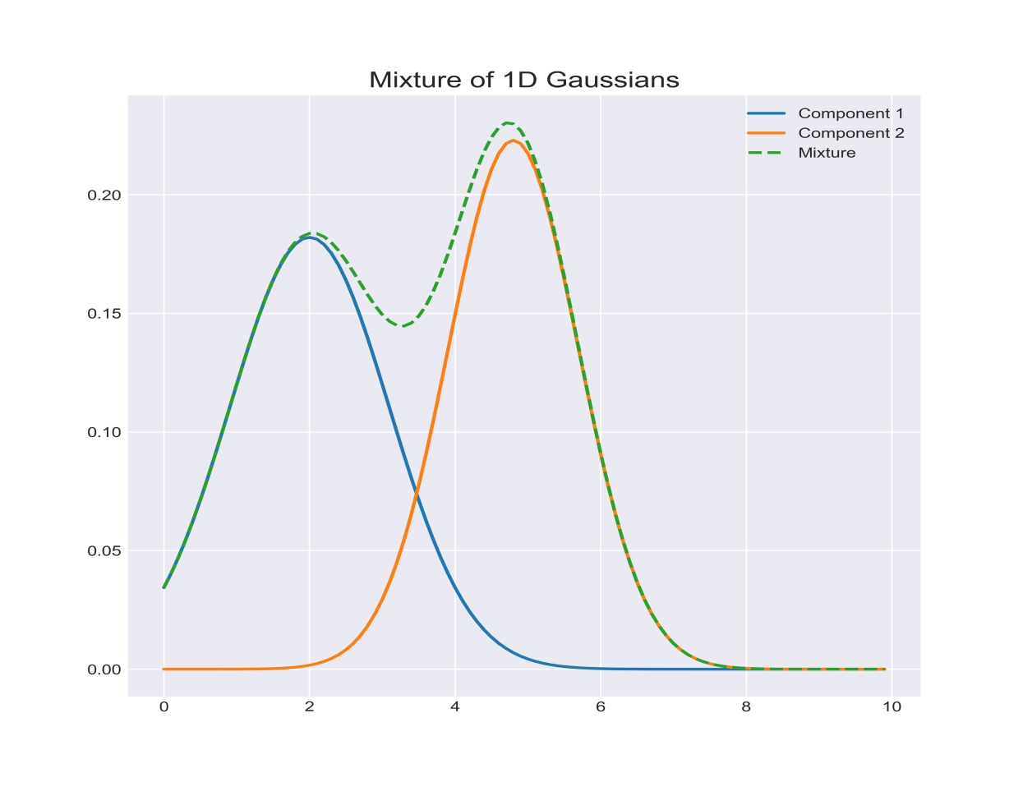
GAUSSIAN MIXTURE MODEL
Gaussian mixture model is used to model the probability density of credit card user's past behavior.
so that the probability of current behavior can be calculated to detect any abnormalities from the past behavior.

Slide 9
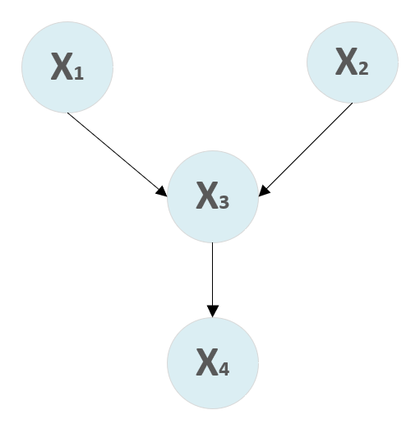
BAYSEIAN NETWORKS
It is used to describe the statistics of a particular user and the statistics of different fraud scenarios.
Task is to explore different views of the same problem .

Slide 10
PROPOSED SYSTEM
In clustering, the idea is not to predict the target class as in classification.
We have used classification algorithms.
In addition, the Ada Boost and majority voting methods are applied for forming hybrid models.

Slide 11
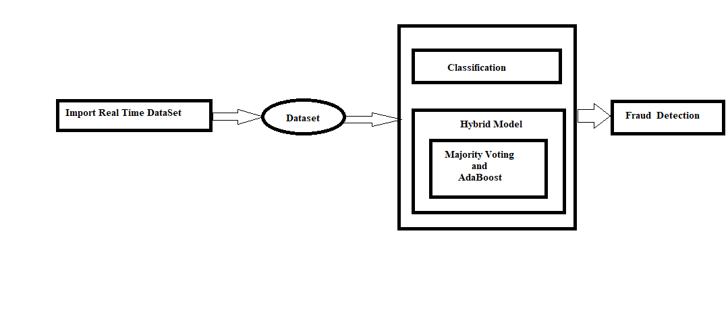
ARCHITECTURE

Slide 12
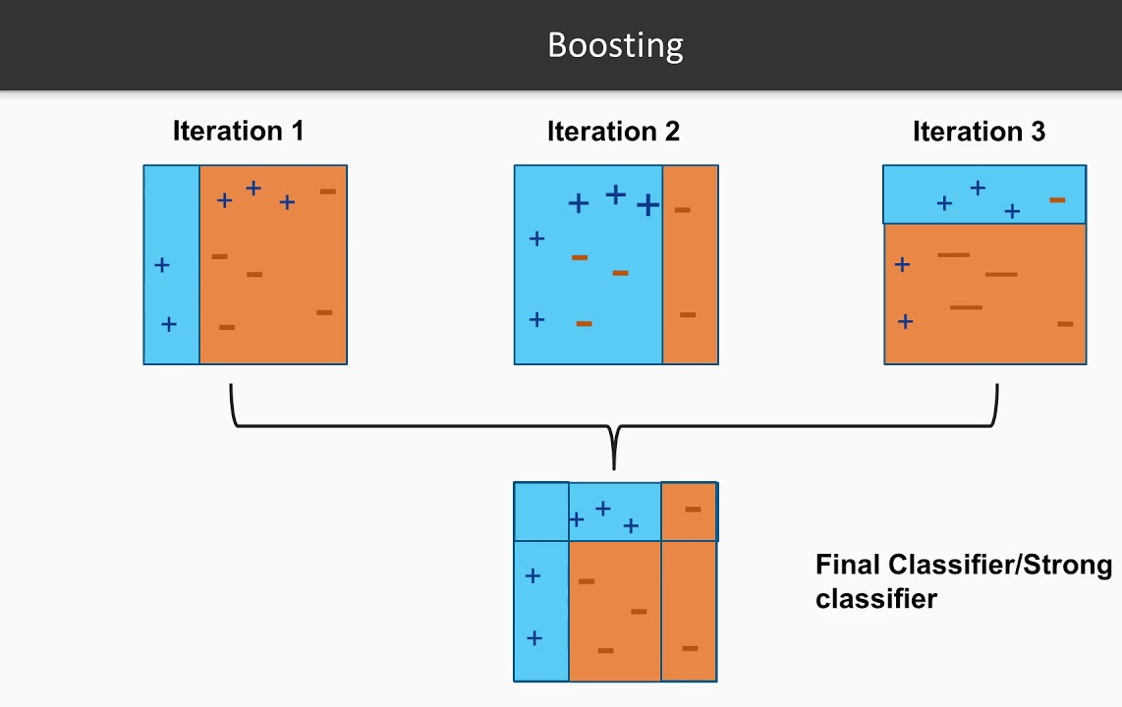
WHAT IS ADABOOST

Slide 13
CONT.....
It can be used in conjunction with many other types of learning algorithms to improve performance.
The outputs are combined by using a weighted sum, which represents the combined output of the boosted classifier.

Slide 14
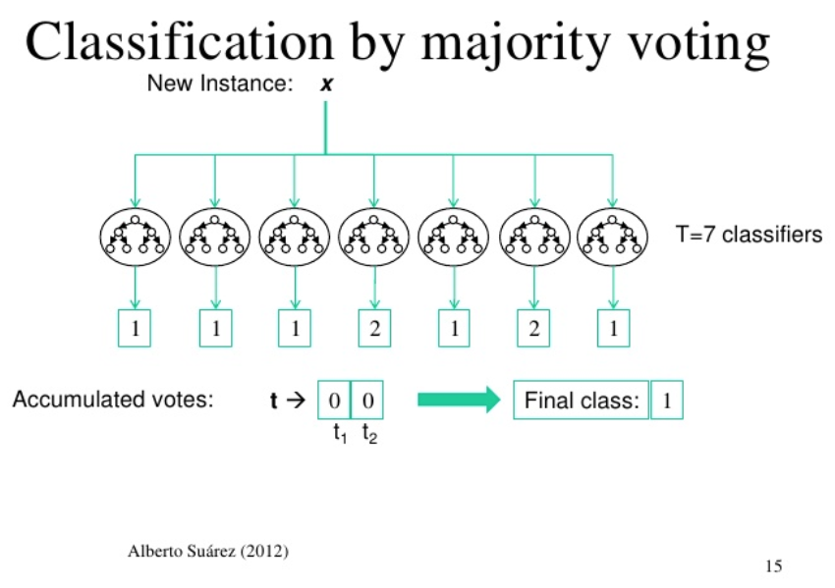
MAJORITY VOTING

Slide 15
CONT....
Every model makes a prediction (votes) for each test instance and the final output prediction is the one that receives more than half of the votes.
If none of the predictions get more than half of the votes, we may say that the ensemble method could not make a stable prediction for this instance

Slide 16
HARDWARE REQUIREMENTS
Processor : Pentium IV(min)
Speed : 1.1 Ghz
RAM : 1GB
Hard Disk : 10 GB

Slide 17
SOFTWARE REQUIREMENTS
Operating System : Windows
Application Server : Tomcat 6 (or) above
Front End : HTML
Scripts : JavaScript.
Server side Script : Java Server Pages.
Database Connectivity : Mysql 5.0. or Above
Java Version : jdk6 or Above

Slide 18
CLASSIFICATIONS
Classification algorithms are classified as
Logical Regression
Naive Bayes classifier
Support vector machines
k-nearest neighbour
Decision trees
Random forests

Slide 19
LOGISTIC REGRESSION:-
Logistic regression is a machine learning algorithm for classification.
In this algorithm, the probabilities describing the possible outcomes of a single trial are modelled using a logistic function.

Slide 20
Naive Bayes:-
A naive Bayes classifier is an algorithm that uses Bayes' theorem to classify objects.
Naive Bayes classifiers assume strong, or naive, independence between attributes of data points.
Spam Filtering.
Text Classification.

Slide 21
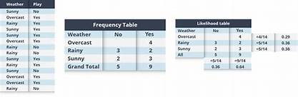
NAIVE BAYES

Slide 22
K-nearest Neighbours
It is a simple algorithm used for both classification and regression problems.
It basically stores all available cases to classify the new cases by a majority vote of its k neighbours.
The case assigned to the class is most common amongst its K nearest neighbours measured by a distance function.

Slide 23
DECISION TREE
Decision tree is the most powerful and popular tool for classification and prediction.
A Decision tree is a flowchart like tree structure.

Slide 24
SUPPORT VECTOR MACHINE
We plot each data item as a point in n-dimensional space (where n is a number of features you have) with the value of each feature being the value of a particular coordinate.
For example, if we only had two features like Height and Hair length of an individual, we’d first plot these two variables in two-dimensional space where each point has two coordinates (these coordinates are known as Support Vectors).

Slide 25
REAL WORLD DATA
A real credit card data set from a financial institution in Malaysia is used in the experiment.
It is based on cardholders from the South-East Asia region from February to April 2017.
A total of 287,224 transactions are recorded, with 102 of them classified as fraud cases.

Slide 26
MODULES
There are three modules:
Bank Admin
E-commerce
User

Slide 27
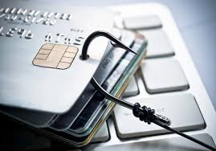
CREDIT CARD FRAUD DETECTION USING ADABOOST AND MAJORITY VOTING
Under the Guidance of
K.B.V.K.NAGASREE K.VAISHNAVI(16E31A1214)
Y.ABHINAYA(16E31A1231)

Slide 28
Bank admin
In this module, the Admin has to login by using valid user name and password.
After login successful he can do some operations.

Slide 29
E-commerce
There are n numbers of users are present.
User should register before doing any operations, if done details will be stored to the database.
After registration successful, he has to login by using authorized user name and password.
Once Login is successful user will do some operations

Slide 30
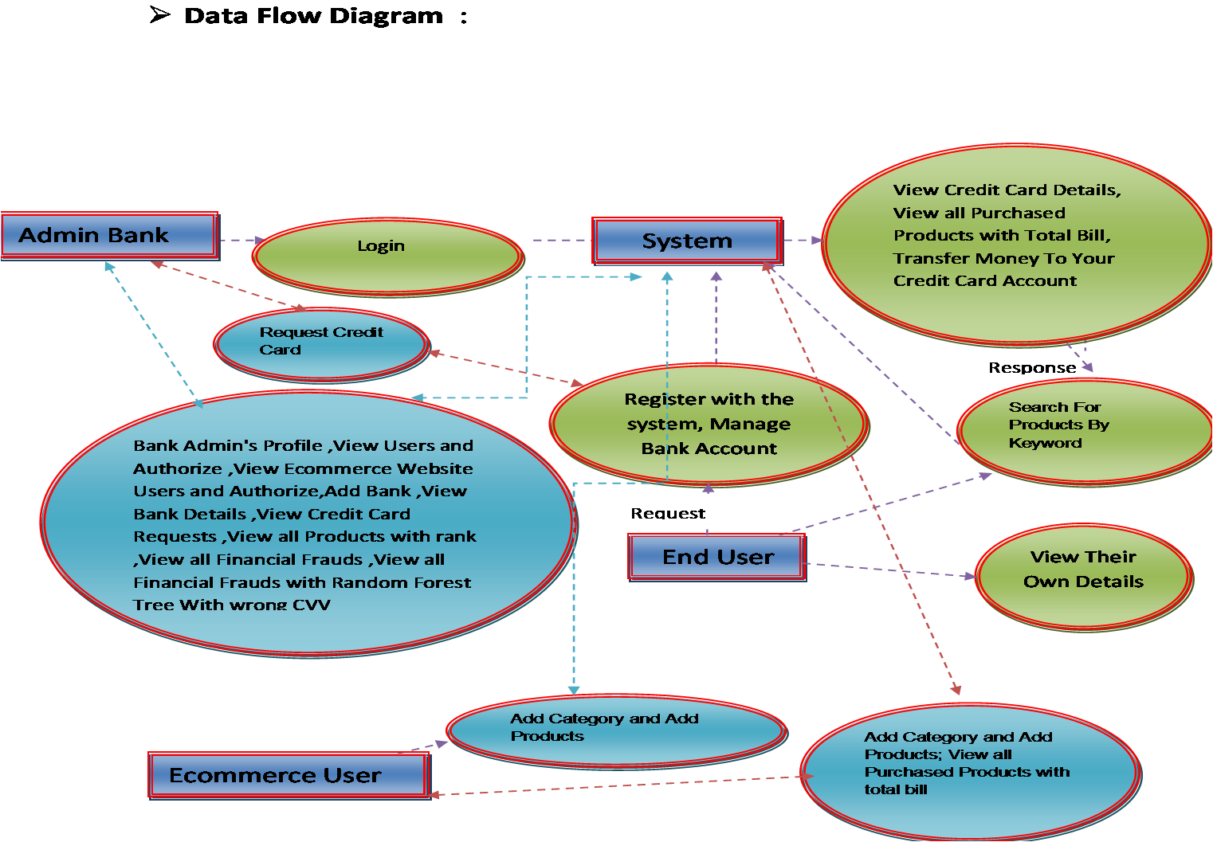

Slide 31
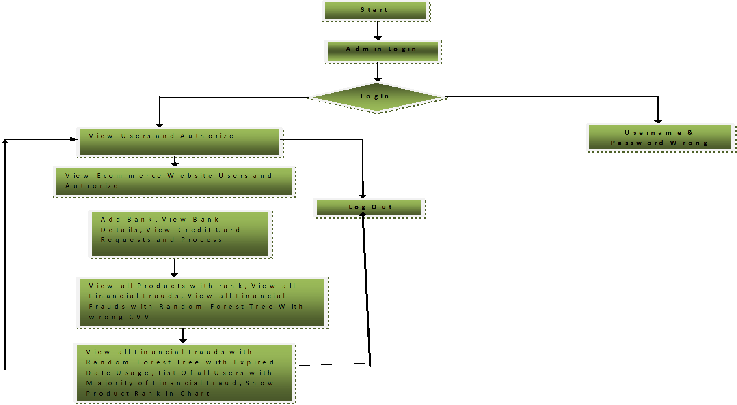
FLOWCHART:ADMIN

Slide 32
FLOWCHART:USER

Slide 33
SEQUENTIAL DIAGRAM

Slide 34
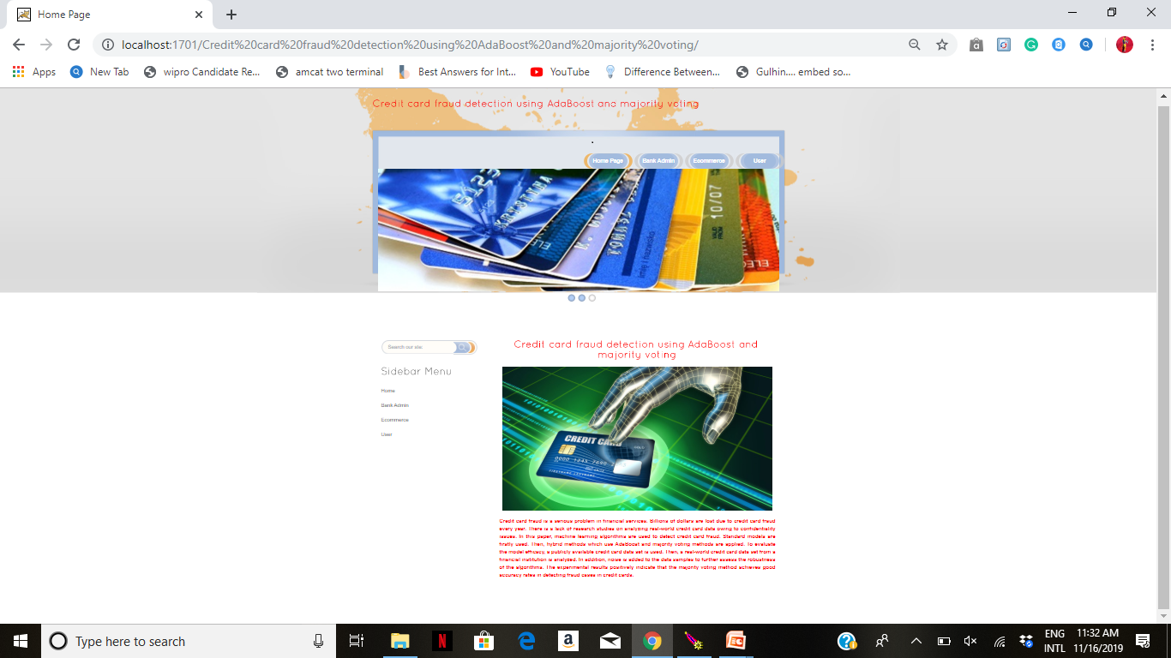

Slide 35
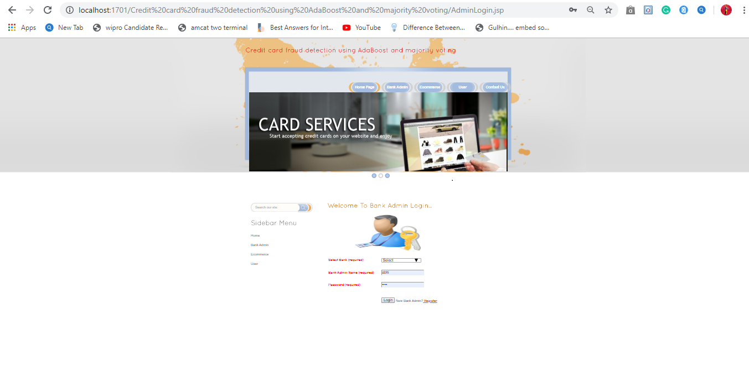

Slide 36
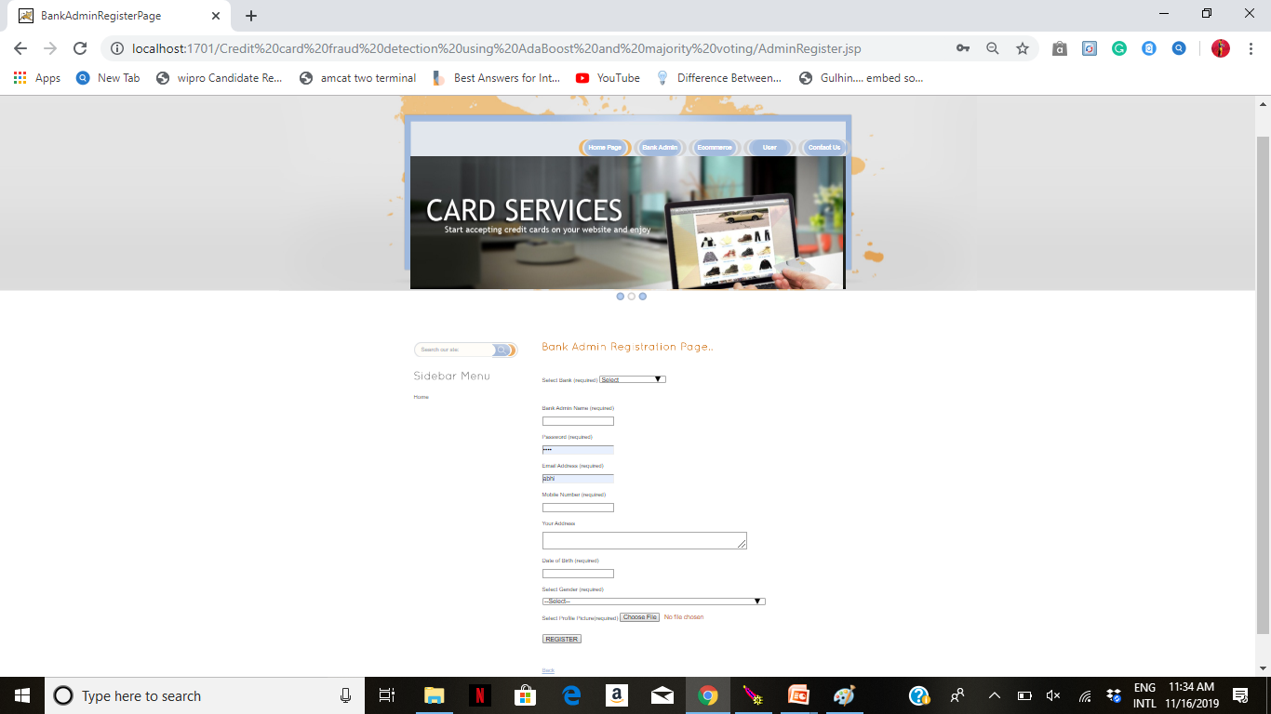

Slide 37
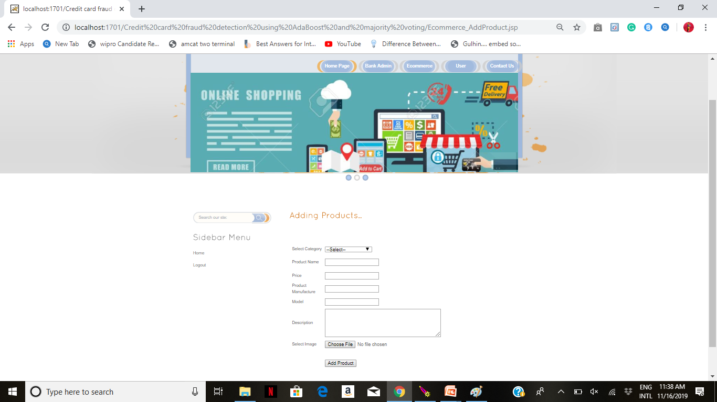

Slide 38
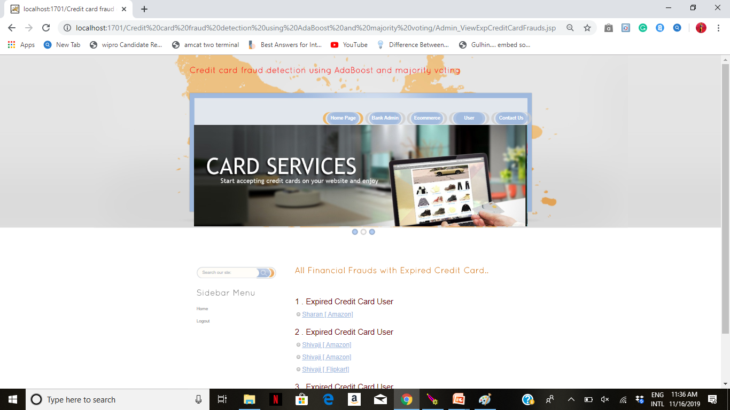

Slide 39
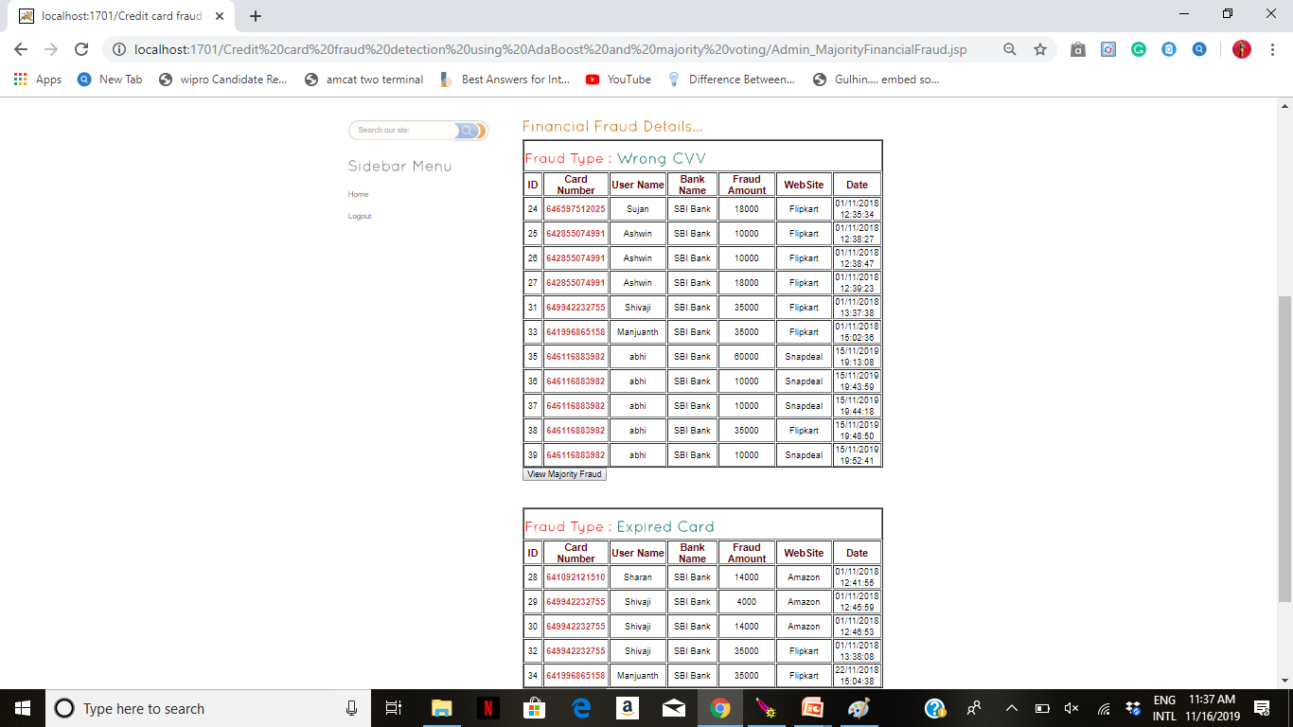

Slide 40
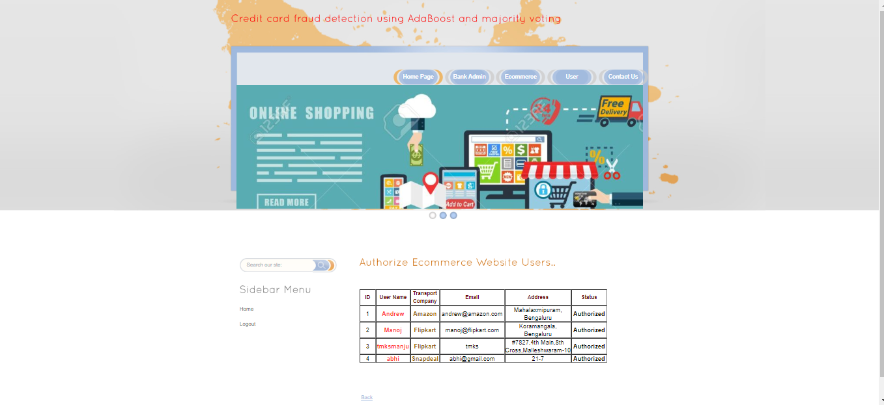

Slide 41
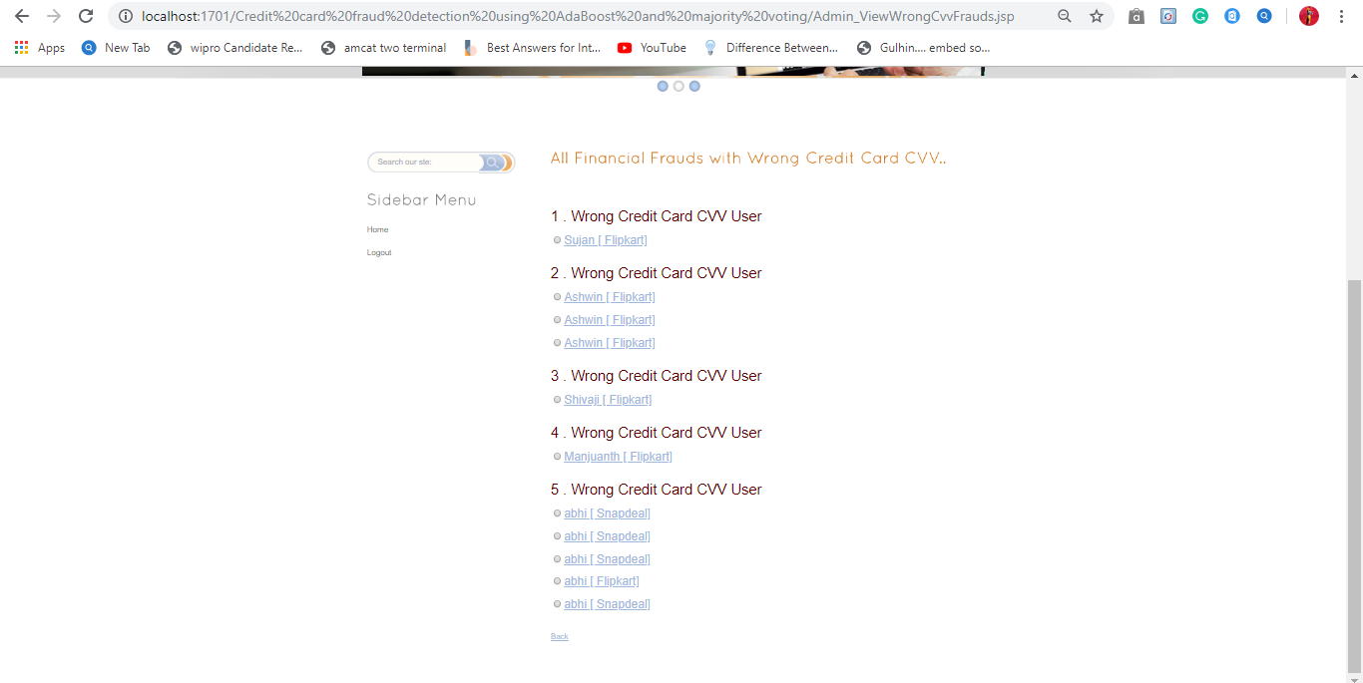

Slide 42
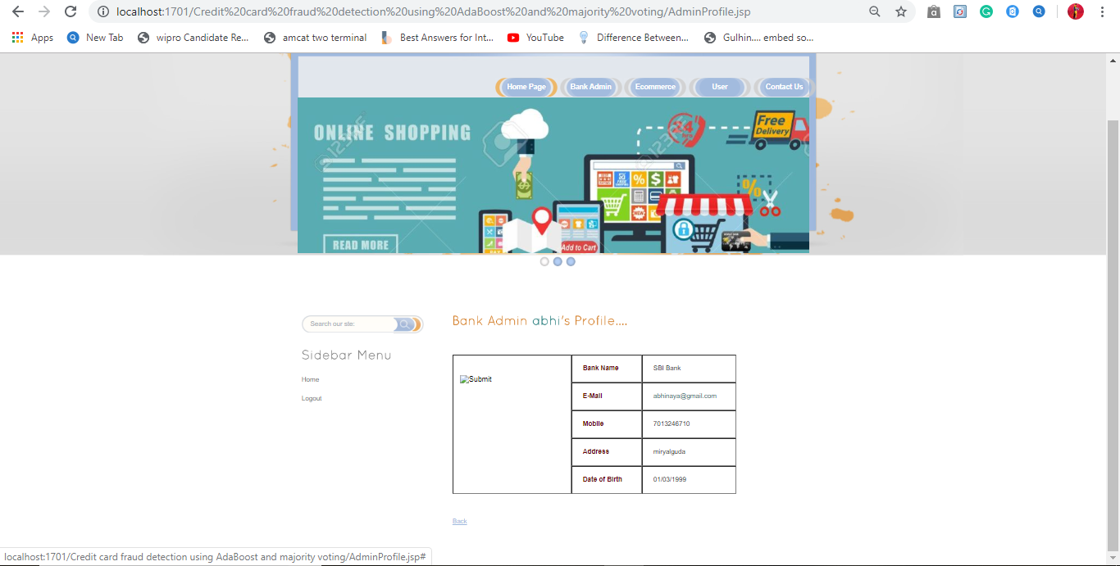

Slide 43
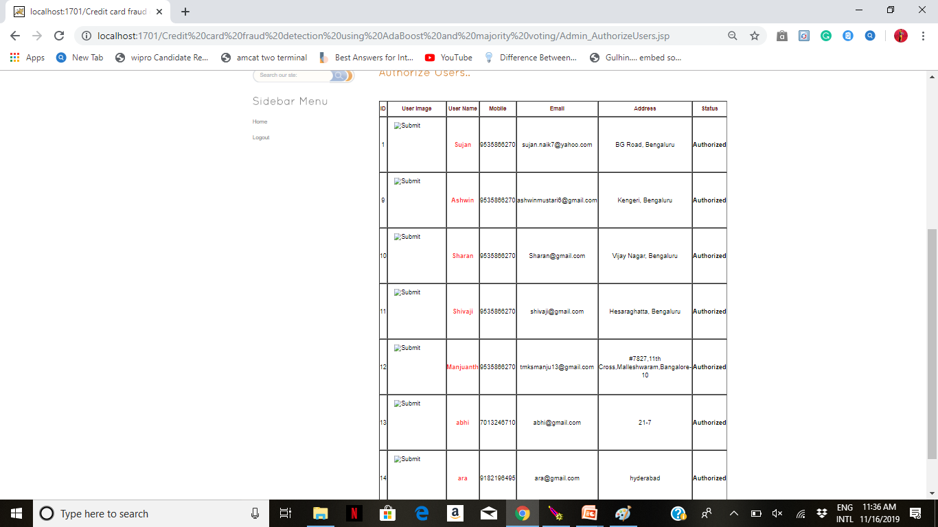

Slide 44
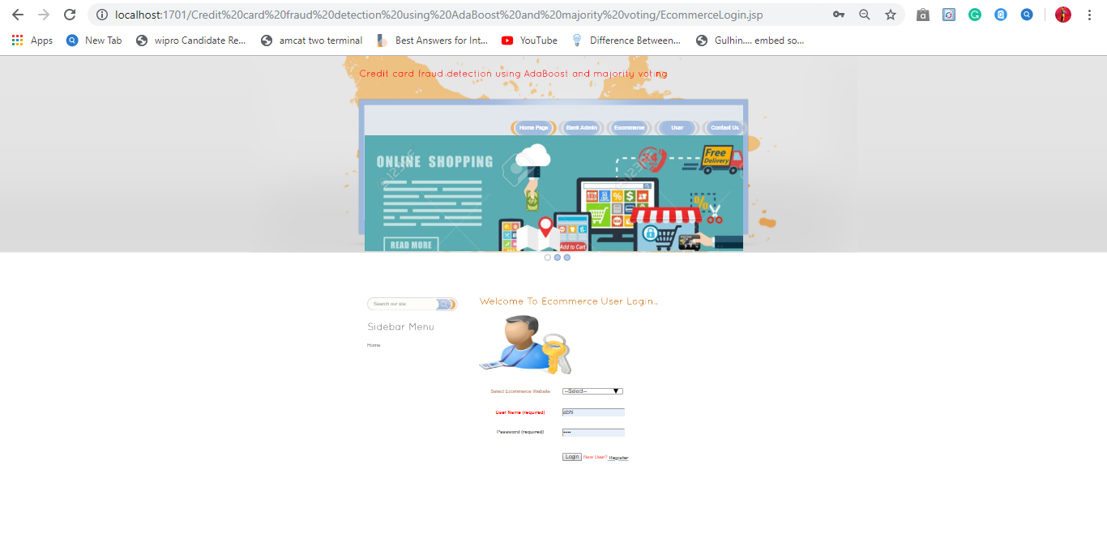

Slide 45
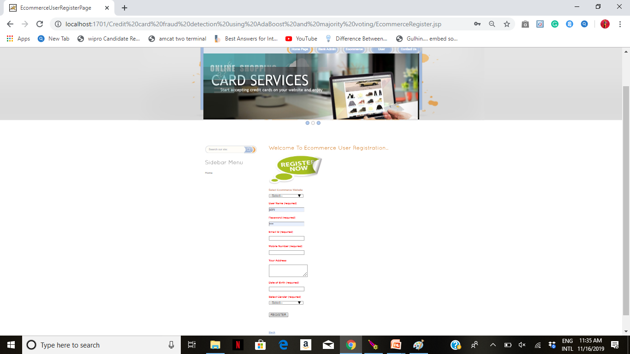

Slide 46
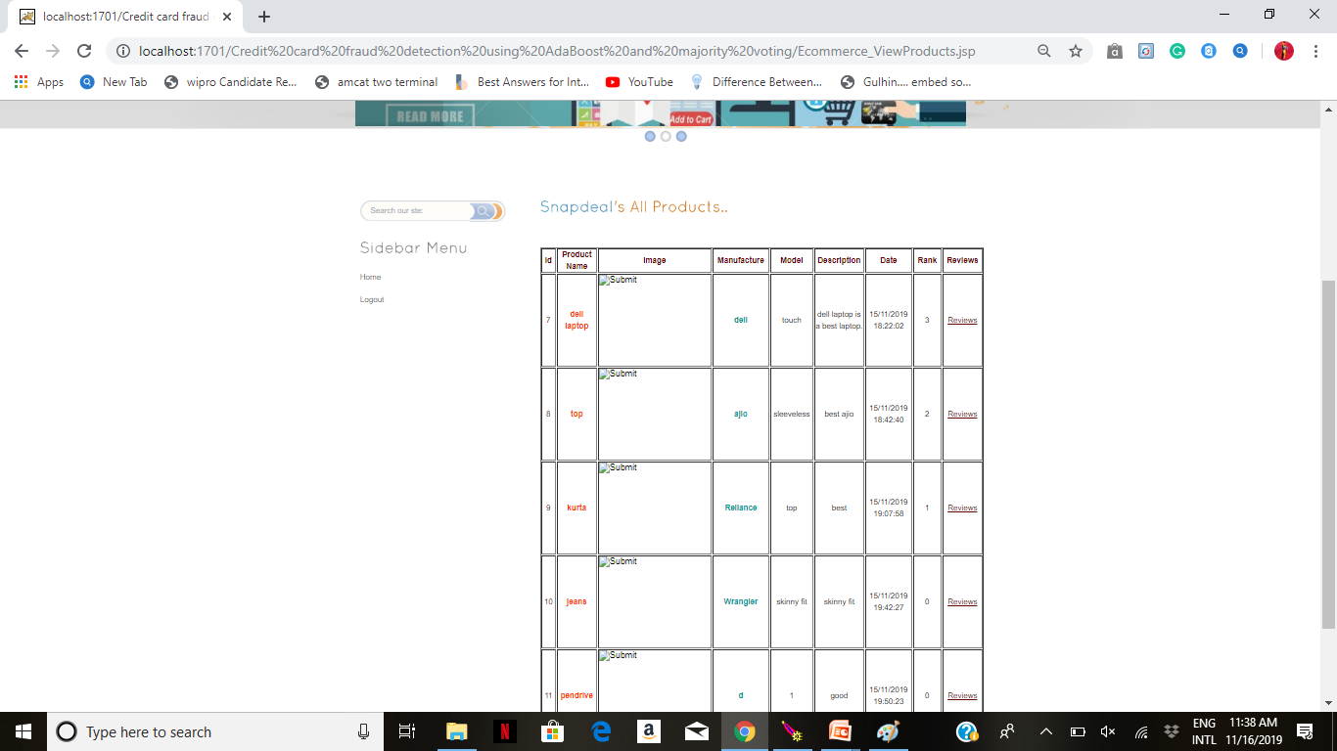

Slide 47
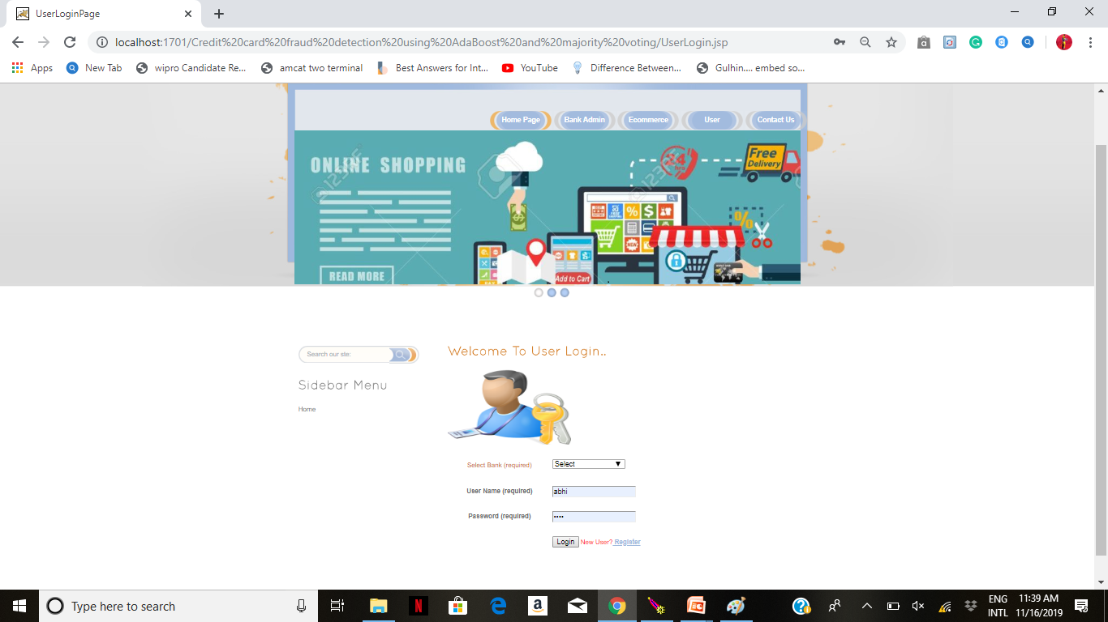

Slide 48
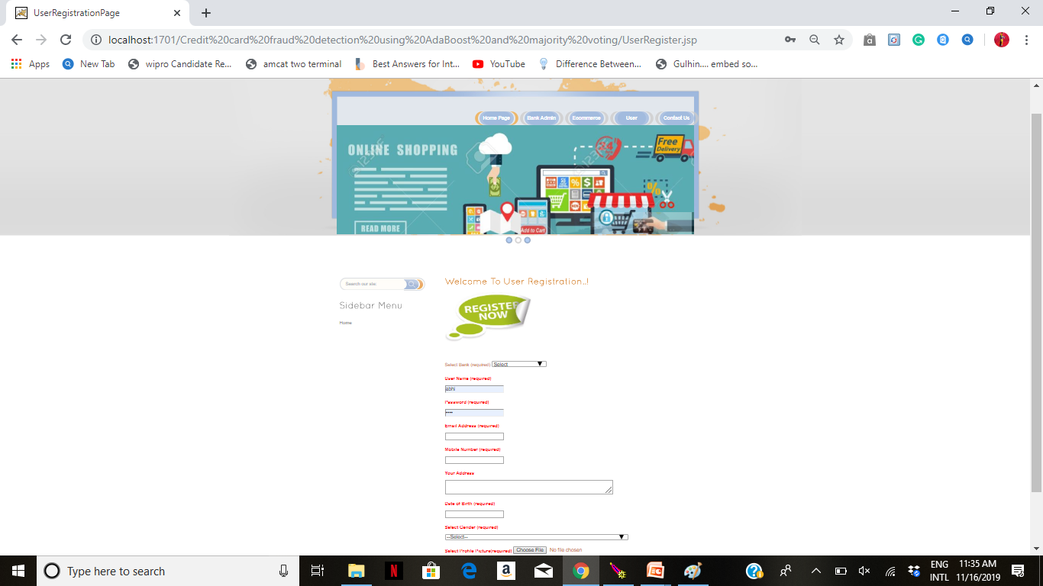

Slide 49
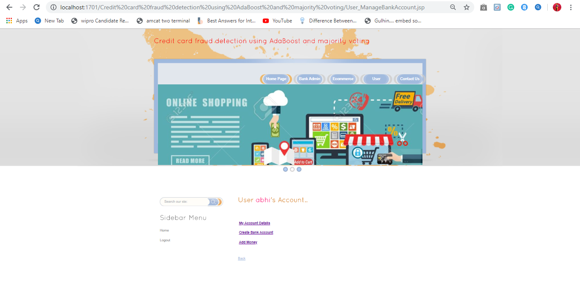

Slide 50
CONCLUSION
A study on credit card fraud detection using machine learning algorithm.
A publicly available and real world credit card data sets has been used for evaluation using individual (classification) models and hybrid models using AdaBoost and majority voting combination methods.
Noise is added for dataset for more accuracy.

Slide 51
FUTURE SCOPE
Fraudster account will be blocked.
No further transcations will be processed
Fraudster location will be tracked.

Slide 52
THANK YOU

